Slide 1
COMP 1531
Tutorial 9
(We’re almost there)

Slide 2
Today’s Agenda:
State diagrams
Generators
Property-based testing
Domain modelling

Slide 3
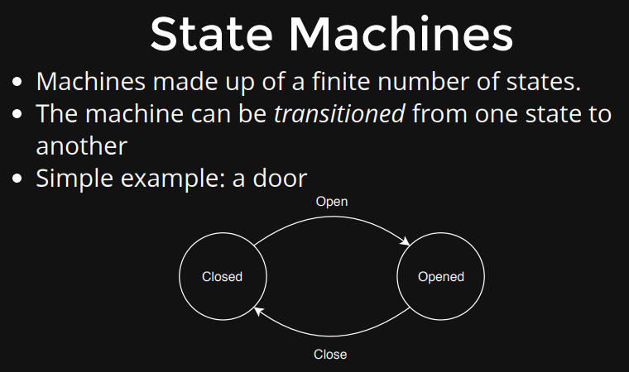
STATE DIAGRAMS:

Slide 4
State Diagram Exercise:
Consider a large modern automated library:
Frequently borrowed books are kept on shelves in the public area.
Library members check out books by scanning a barcode with a phone app.
Once a book on the shelf has not been borrowed for 6 months, it is moved to the basement archive.
Members can borrow books in the archives by requesting they be brought up by robot and delivered directly to them. Scanning is not required.
Books are returned by members putting them on the shelves and using the phone app to acknowledge their return.
Model the possible states an individual book can be in as a state diagram. Assuming the robots fail regularly (most do), what state would the books they were carrying be in?

Slide 5
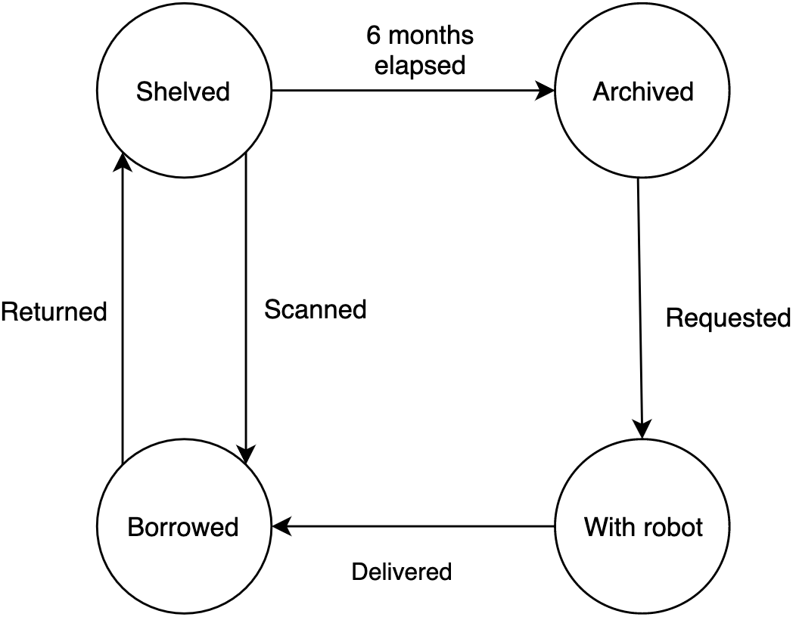
Library

Slide 6
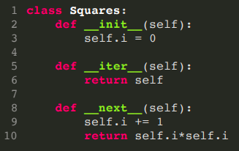
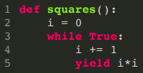
B. GENERATORS:
ITERATOR ->
Main differences between Iterators and Generators in python.
A generator in python makes use of the ‘yield’ keyword, the generator stops looping when it hits ‘yield’ until it’s ‘next()’ method is called again (which we can automate with loops)
Python generator saves the states of the local variables every time ‘yield’ pauses the loop, while if you want variables in an iterator, you need to put them in through the constructor.
A generator does not need their own class in python but iterators do.
GENERATOR ->

Slide 7
Run-length
Run-length encoding is a technique for compressing data with many adjacent repeated values.
It works by converting a string into a series of tuples, (c,n), where c is the character and n is the number of times it is repeated.
For example, the string Helllloooooo! is encoded as [('H',1), ('e',1), ('l', 4), ('o', 6), ('!',1)].

Slide 8
Task
Write a generator, encode(string), that generates the run-length encoding of a given string.
Why this is better than a conventional iterator or a function that returns a list?
Slide 6, point 2: we don’t have to explicitly define state for generators since it maintains it for us between next() calls
Write a function, decode(encoded), that converts the encoded data back to a string.

Slide 9
C. Property Based Testing:
Kind of like mathematical testing - you are looking should satisfy certain properties
Some examples:
Running a function on input, run it again on the result of the first run, and get back what you started with i.e. self-inverse
Like a function that multiplies by (-1)
Idempotence: running a function repeatedly gives the same result as running it once
Like a sorting function. If I sort my list once, it is sorted, running the function any number of times after that wont give new results.
If you can test these properties hold, you’re in a good position to believe your code is functioning how you expect

Slide 10
Property-based Testing
What property do the encode() and decode() functions have that can be expressed as a property-based test?
Write this test using hypothesis in python.
Generates the data for you to test a property holds for a large number of cases
Assuming that the functions satisfy this property, is that sufficient to guarantee they work correctly?
ABSOLUTELY NOT! But why?
For example, I write a bubble search. But I write my conditions for swapping as:
if number[i+1] > number[i]:
swap(number[i+1], number[i])
My list will be in reverse order, testing for idempotence will not show me this!
Combine output testing with property-based testing for holistic approach

Slide 11

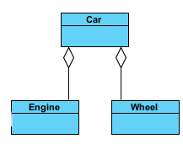
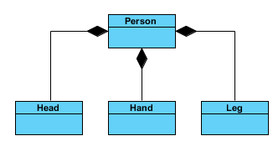
D. More Domain Modelling:
Association: two objects interact but one doesn’t “own” the other, they are separate entities
Aggregation: one object owns the other in their relationship, but the one being owned can still exist in out system if it isn’t owned
Composition: what is being used to form the composition cannot exist outside it’s container
Cardinality: 1-to-1, 1-to-many, many-to-many

Slide 12
Couch surfin’
Develop a domain model (as a UML class diagram) for the following system:
Members of a website can rent out their couches to other members for a number of nights.
After the stay, guests leave reviews for their hosts and hosts for their guests.
In addition to a short description, reviews also contain a 5 star rating.
Reviews are flagged as exceptional, if the the star rating given is at or above the reviewers average, and/or dubious, if the star rating is significantly above the reviewees average rating.
Implement the domain model as a series of classes in python.

Slide 13
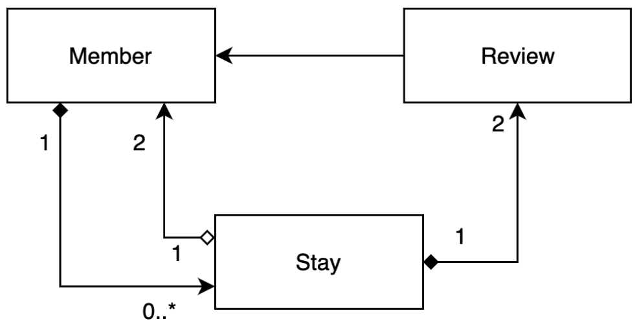
Renter and owner parties
Renter reviews couch
Owner reviews renter
A member can stay in many different couches. But a couch will only have 1 member in it at one time

Slide 14
